Slide 1

Tangent + TGT: The First Protocolized Trade-Finance Engine
Instant, rules-based, USD-backed solutions bridging the $5T+ trade finance gap through programmatic validation and settlement, eliminating traditional banking bottlenecks.

Slide 2

Problem: Banks Are the Weakest Link
Lengthy Onboarding
Outdated Instruments
Weeks of KYC procedures and months to establish credit limits, creating significant barriers to entry for new market participants.
Letters of credit and other archaic financial instruments cause extensive delays in document handling and verification processes.
Manual Processes
Each transaction requires separate manual evaluation, introducing human error, inconsistency, and inefficiency into the trade finance ecosystem.
When markets shift, banks often revoke commitments, destroying trust, delaying supply chains, and contributing to the massive $5T+ global trade finance gap that cripples cross-border commerce.

Slide 3

Solution: Tangent Protocol
Transaction-Based Financing
Finance the specific transaction, not the company or bank, removing subjective credit assessments.
Programmatic Validation
Trades validated against protocol rules (parties, documents, collateral) with built-in risk minimization.
Instant Settlement
If conditions are met → financing instantly released via TGT stablecoin for immediate USD settlement.
Our programmable LC replacement enhances trust and enables seamless document handling while containing fraud and counterparty risk by design.

Slide 4

Why Tangent Is Unique
"If a truly programmatic trade finance solution existed, we'd already be using it."
The Status Quo
The Tangent Difference
Banks and fintechs rely on subjective credit committees
Programmatic validation against protocol rules
Manual limits set per counterparty
Transaction-level assessment, not entity-level
Human gatekeepers for each transaction
Instant decisioning and settlement
Institutional bias against emerging markets
First true protocol bypassing traditional banking bottlenecks
Our trading team has searched extensively for solutions like this in the market—the fact that we're building it ourselves is the strongest proof that nothing comparable exists.

Slide 5


Why Now Is the Perfect Time
$5T
$150B+
2023-24
Trade Finance Gap
Stablecoin Market
Regulatory Clarity
Global shortfall in available trade financing, growing as banks retreat from emerging markets
Rapidly growing market cap of stablecoins, the fastest expanding digital asset class
New frameworks like MiCA in Europe and ADGM enabling compliant stablecoin issuance
As banks continue retreating from emerging markets, the financing gap widens—creating a perfect environment for protocol-based solutions to fill the void. The maturation of stablecoin infrastructure provides the technical foundation we need to execute our vision.

Slide 6

Product Vision
Tangent V1
TGT Token
Digital trade finance flows with programmatic validation of parties, documents, and collateral, enabling instant financing decisions based on transaction merit rather than counterparty reputation.
USD-backed settlement token providing immediate liquidity for approved transactions, with 1:1 dollar backing and full regulatory compliance for cross-border settlement.
Finance Pool
Institutional participation vehicle offering short-term yield from trade finance activities, creating a sustainable capital source for the protocol's financing operations.
The end-to-end flow connects suppliers, traders, and buyers with instant financing through our protocol, eliminating traditional banking delays and uncertainty.

Slide 7
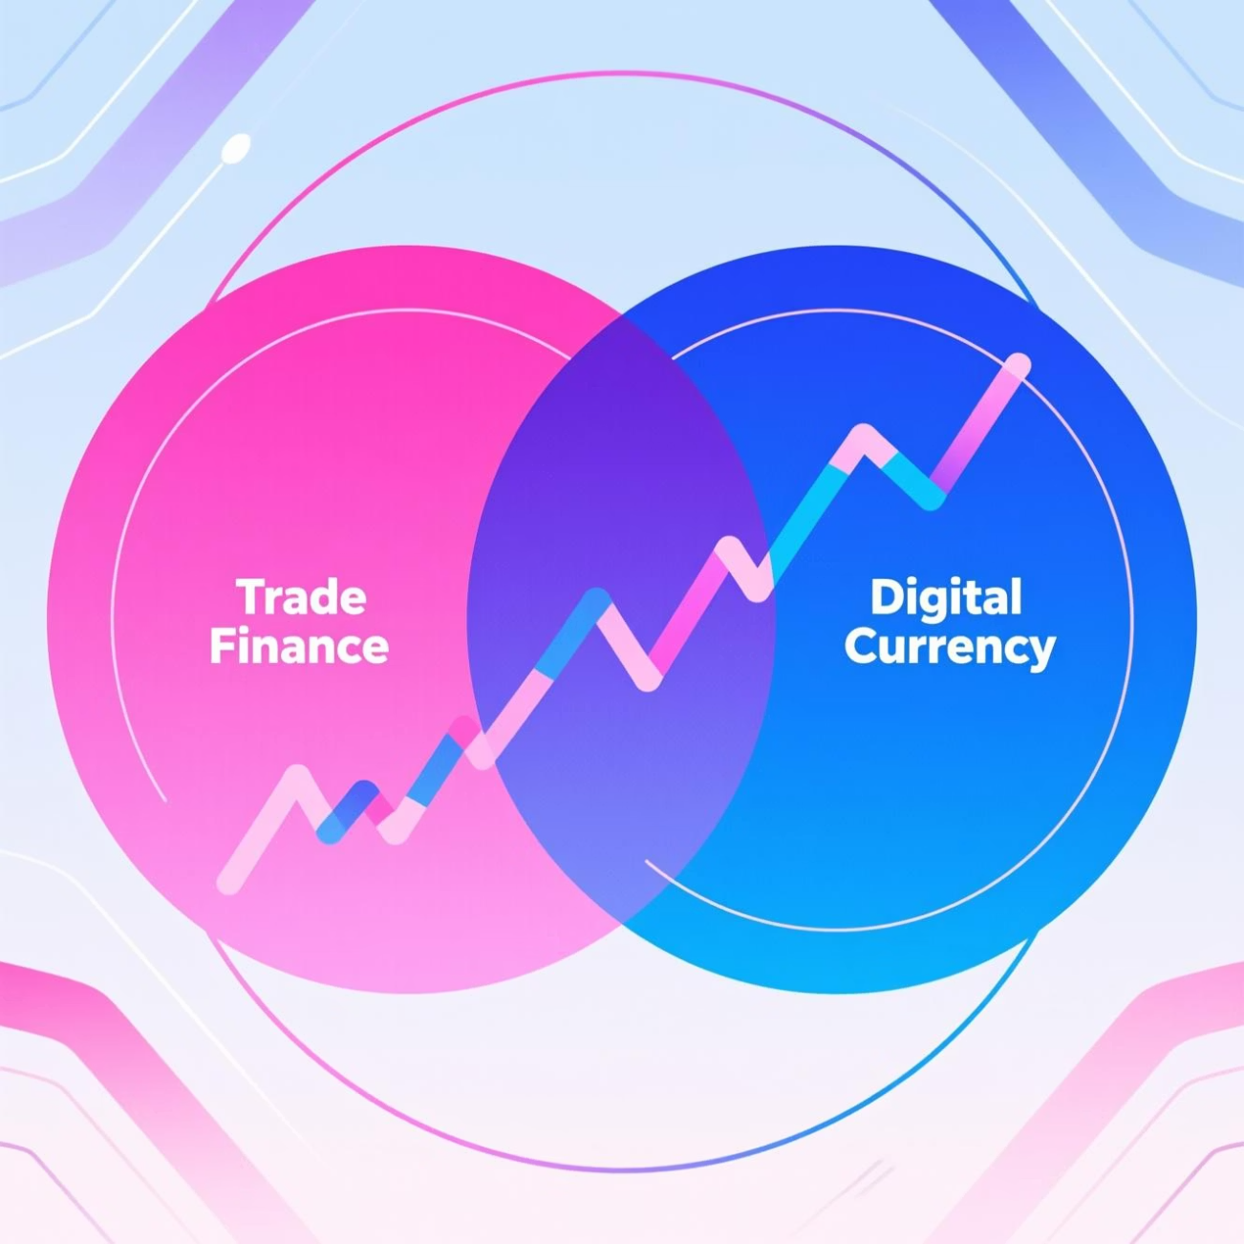
Market Opportunity
Massive Addressable Markets
$5T
$150B
Trade Finance Gap
Current Stablecoin Market
Unmet financing needs in global trade, primarily affecting SMEs and emerging markets
Rapidly growing with projections reaching $1T+ by 2030
$2.7T
Annual Trade Finance Volume
Current bank-intermediated trade finance representing our initial target market
Tangent + TGT operate at the high-growth intersection of traditional trade finance and digital USD settlement rails, creating a unique market position.

Slide 8

Business Model
TGT Revenue Streams
Tangent Protocol Fees
Reserve yield from USD backing (3-5% annually on reserves)
Trade finance fees (0.5-1% per validated trade)
Mint/redeem fees (5-10bps per transaction)
Document processing fees
API access for enterprise integration
Potential network fees for settlement services
Finance Pool Economics
2% management fee on committed capital
Performance carry on yields above threshold
Institutional capital deployment vehicle
The business achieves break-even at approximately $500M TGT circulation, with multiple complementary revenue streams creating a sustainable economic model. Our fee structure is significantly more competitive than traditional banking alternatives while offering superior speed and certainty.

Slide 9

Roadmap to Scale
1
0-6 Months
Productize MVP with core validation logic
Compliance and regulatory integration
Initial pilot transactions ($1-5M volume)
Key partnership development
2
6-12 Months
TGT soft launch ($10-20M circulation)
Regulatory approvals in key jurisdictions
First institutional participants onboarded
Transaction volume reaching $50M monthly
3
12-18 Months
Finance Pool launch for institutional capital
Exchange and PSP integrations
API gateway for enterprise clients
Expanded commodity coverage
4
18-24 Months
$100M TGT circulation target
100+ trades processed monthly
Multi-jurisdiction operational capability
Series A fundraising preparation

Slide 10

Team
Leadership
CEO: Seasoned operator with extensive trade-finance expertise and successful startup experience
CFO: Institutional-grade finance executive (full-time) with regulatory compliance background
Development
Core development team based in Israel with expertise in financial protocols, smart contracts, and secure systems architecture
Business Development
Strategic BD hub established in Dubai, providing access to key trade finance corridors and emerging market opportunities
Our team combines deep domain expertise in trade finance with technical capabilities in digital asset infrastructure, creating the perfect blend of experience to execute our vision.

Slide 11

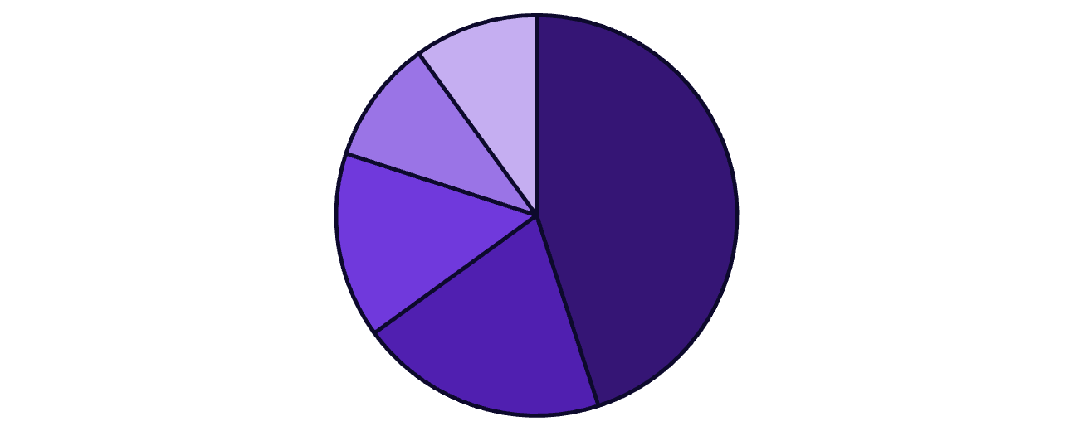

Financials
$5M
$240K
Capital Allocation
Seed Raise Target
Monthly Burn Rate
Providing 24-month runway for product development and initial market entry
Steady-state operating expenses including executive salaries and development costs
$4.8M
Total 24-Month Spend
Engineering
Compliance
BD & Marketing
Allocated across development, compliance, marketing, and operations
Operations
Reserves
Note: TGT reserve raise of $100M will be structured separately from equity financing, specifically for stablecoin backing.

Slide 12





Funding Ask & Vision
Investment Terms
Raise: $5M Seed equity
Valuation: $20M pre-money (20% equity)
Use of funds: Product development, TGT launch, and go-to-market strategy
Long-Term Vision
Tangent will become the global settlement layer where real-world trades are financed instantly through objective, protocol-driven validation—eliminating subjective gatekeepers and democratizing access to trade finance.
"We're not just building another fintech solution—we're creating the fundamental infrastructure for the next generation of global trade."
Protocol Development
Regulatory Framework
TGT Launch
Market Expansion

